Slide 1
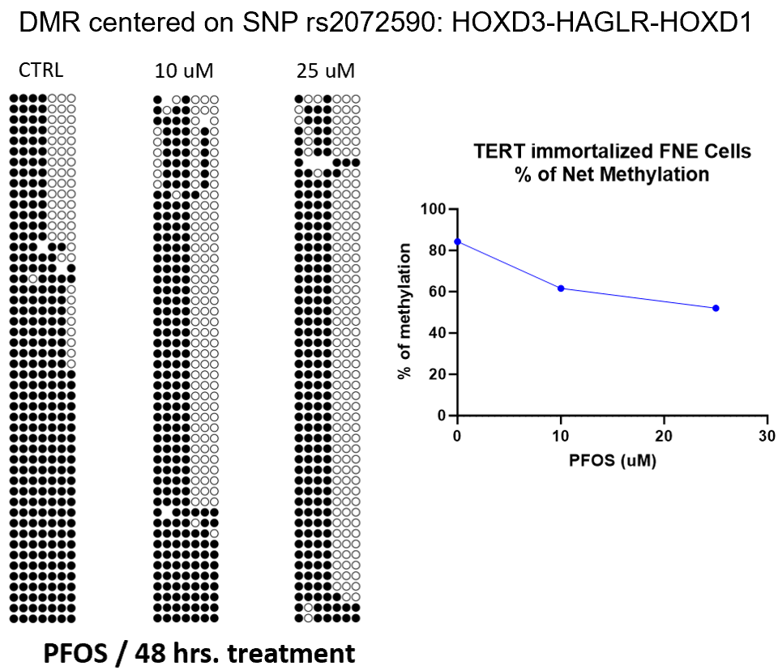
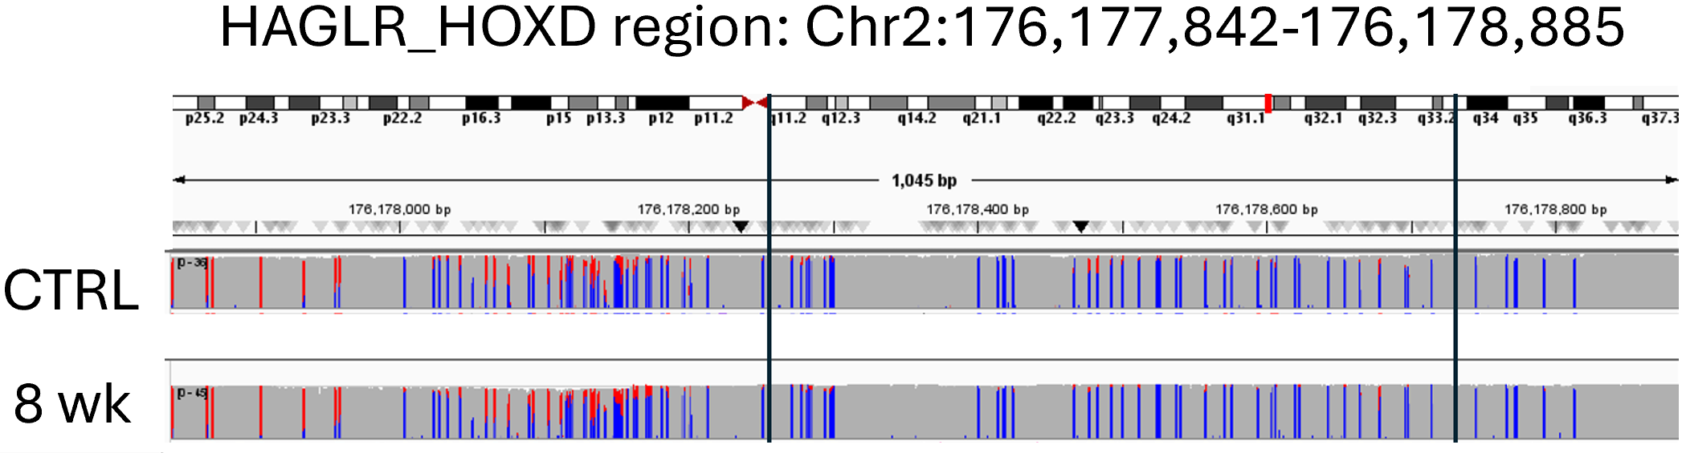
Methylome Signatures of Different PFOS Exposures in Cultured Fallopian Tube Non-Ciliated Epithelial Cells
Rohan Sarkar, Cornell University
Dr. Benjamin Tycko, Center for Discovery and Innovation
INTRODUCTION & OBJECTIVES
Perfluorooctane sulfonic acid (PFOS), a legacy compound within the broader PFAS chemical class, is a persistent environmental toxicant associated with carcinogenicity, immune dysregulation, and endocrine disruption. Its ubiquity in water systems and industrial runoff has led to disproportionate exposure in environmental justice (EJ) communities, where systemic inequities in infrastructure and proximity to contamination sources amplify health risks. This study explores the epigenetic consequences of PFOS exposure in fallopian tube non-epithelial (FNE) cells, with a particular focus on DNA methylation changes. The primary objectives are to characterize methylation profiles under both short- and long-term PFOS exposure, identify differentially methylated regions (DMRs), compare methylation shifts with transcriptomic data, and assess the potential of methylation as a biomarker for PFOS-induced toxicity.
METHODS
In collaboration with the Iwanicki Lab (Stevens Institute of Technology), we sequenced TERT-immortalized FNE cells to model PFOS exposure under two distinct regimens: a short-term high-dose exposure of 25 µM for three days, without and with a three-day washout, and a long-term low-dose exposure of 20 nM for eight weeks, without and with either a three-day or one-week washout. Whole-genome methylation profiling was conducted using Oxford Nanopore sequencing technology.
RESULTS & DISCUSSION
Long-term, low-dose PFOS exposure elicited more pronounced methylation changes than short-term, high-dose exposure. This was in line with the transcriptomics data generated by the Iwanicki Lab. Surprisingly, overall methylation alterations were modest, particularly in short-term samples, challenging prior assumptions about PFOS’s potency as a methylation disruptor. The Tycko Lab has previously performed targeted methylation sequencing (via Illumina MiSeq) on two-day PFOS exposures on TERT-immortalized FNE cells. Previously observed differentially methylated regions, such as that around HOXD did not exhibit significant changes in the Iwanicki Lab long-term exposure samples. This may be attributable to differences in sequencing depth between the targeted and whole genome technologies. Transcriptomic data did not consistently align with methylation changes, indicating that PFOS may exert its effects through alternative regulatory mechanisms. A prior whole methylome study on breast epithelial cells (Pierozan et al., 2024) found extensive methylation changes in response to lower PFOS concentrations, underscoring the role of cell type specificity.
Comparison of Sequencing Depth and Methylation of Prior Year Short-Term and Recent Long-Term Exposures
CONCLUSION & IMPACT
This study demonstrates that PFOS exposure leads to subtle but detectable changes in DNA methylation within FNE cells, with long-term, low-dose exposure producing more epigenetic alterations than short-term, high-dose treatment. The unexpectedly mild methylation response suggests that PFOS’s toxicological profile may not be fully captured by methylation analysis alone and highlights the need to investigate alternative mechanisms of action. For EJ communities disproportionately burdened by PFAS contamination, these findings offer molecular insight into potential health risks and support the development of targeted biomarkers and policy interventions aimed at promoting environmental health equity.
REFERENCES CITED
Pierozan, P., Höglund, A., Theodoropoulou, E., & Karlsson, O. (2024). Perfluorooctanesulfonic acid (PFOS) induced cancer related DNA methylation alterations in human breast cells: A whole genome methylome study. The Science of the total environment, 949, 174864. https://doi.org/10.1016/j.scitotenv.2024.174864
Special Thanks to the Staff of Tycko and Iwanicki Labs

