Slide 1
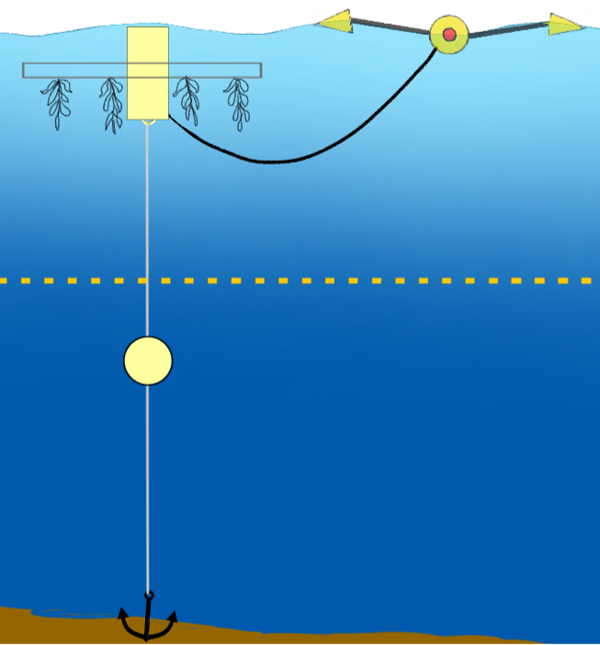
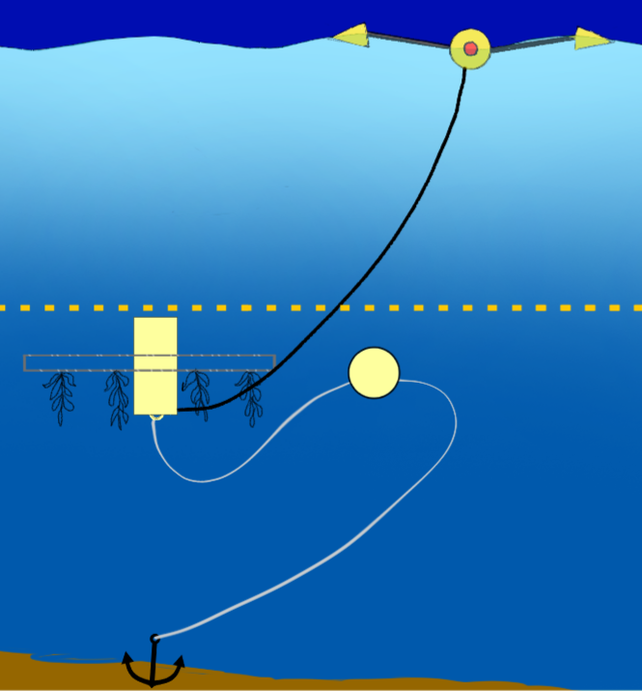
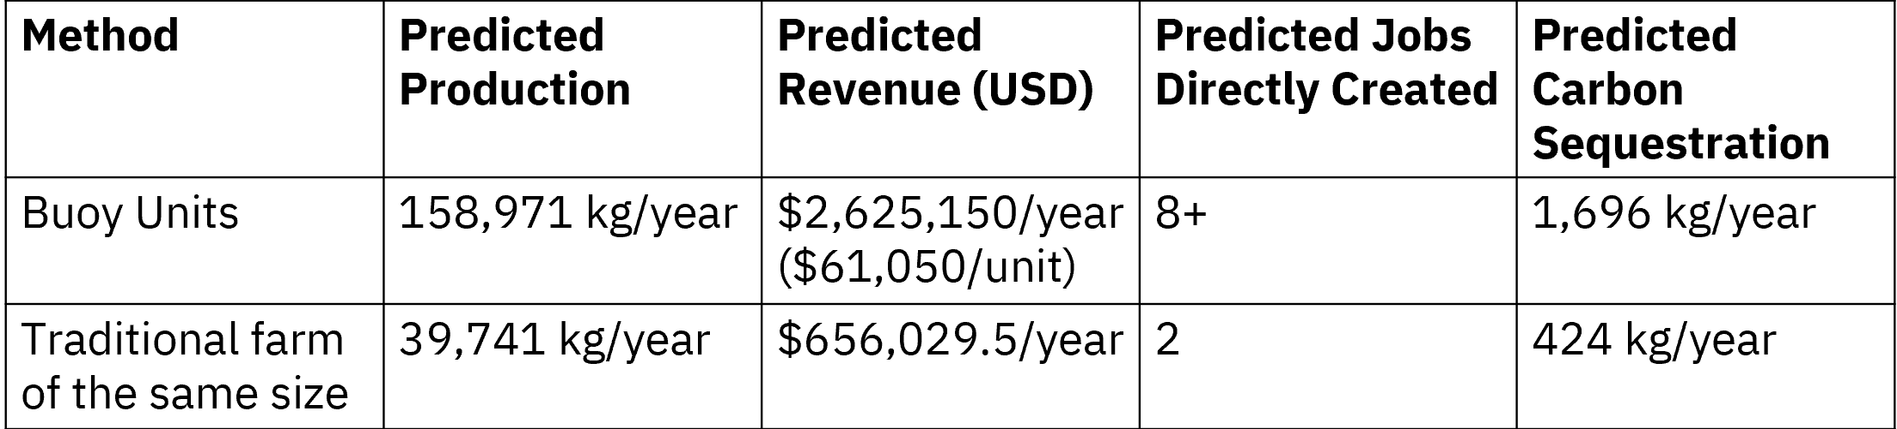
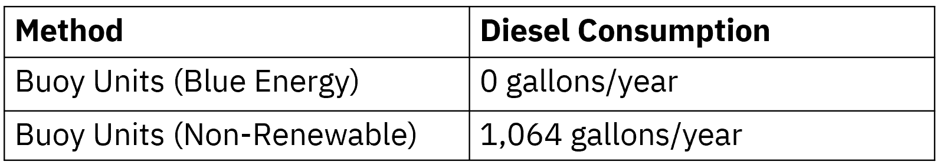
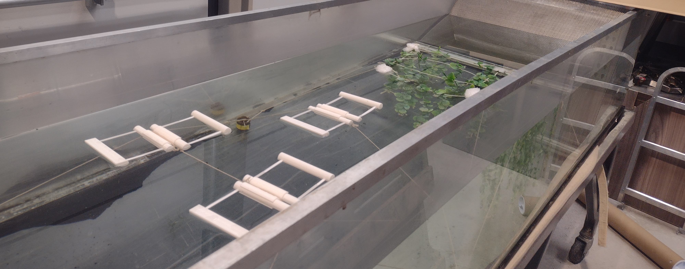
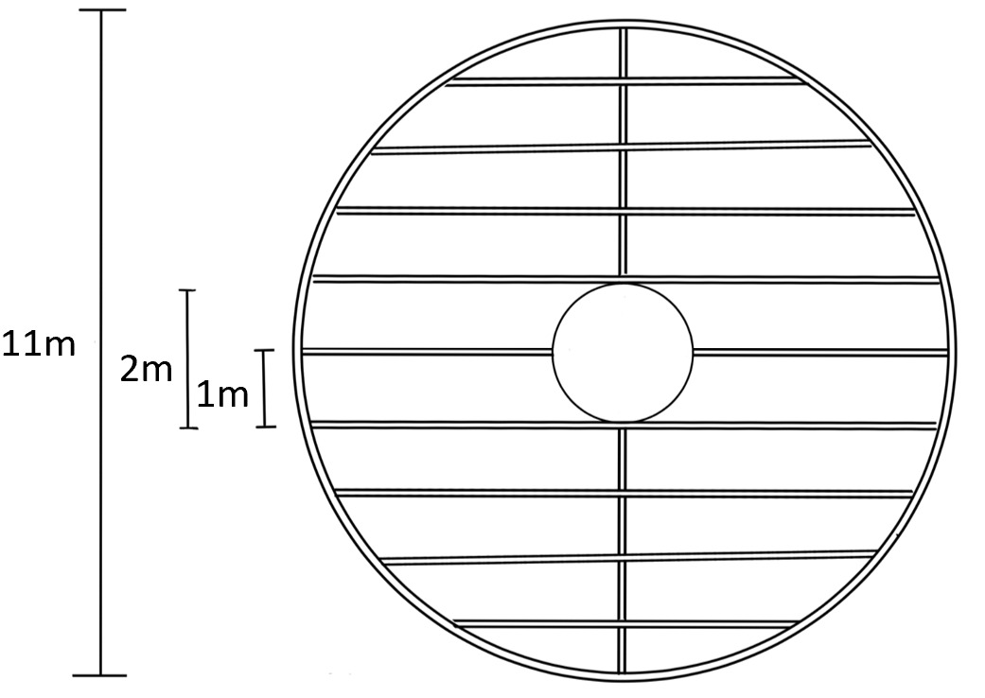
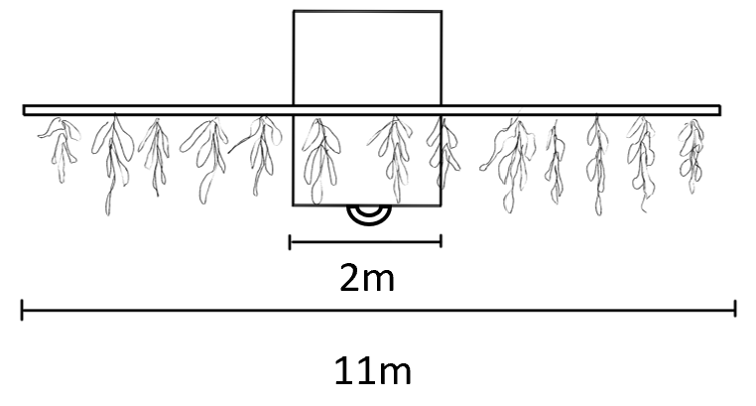
AquaEmpower: Marine Energy Powered Offshore Aquaculture System
Emily Lossman, Stevens Institute of Technology,
Professor Jia Mi, Stevens Institute of Technology
Introduction
This research involves both the design and analysis of a blue energy powered, mechanized seaweed farm to determine whether modern engineering and technology has to potential to ease the financial and ecological burdens on members in coastal environmental justice communities.
Hypothesis & Questions:
Hypothesis: It is possible to develop an economically viable and sustainable mechanism to empower environmental justice communities.
Directing questions:
Is seaweed the ideal form of mariculture to focus on to positively impact environmental justice communities?
What mechanism might improve upon the established cultivation method of this form of mariculture?
How does it compare to existing methods economically and environmentally?
(image of a traditional seaweed farm)
Final Design Operational:
Analysis Results
To compare the final design to commercial farms, estimates are based on a farm of 43 buoy units.
Production, Economic, and Environmental Comparison:
Small Wave Tank Model:
80 m
The final design
raises and lowers
to optimize
sunlight and
nutrient uptake.
Methodology
Research Design: This project follows an experimental design, aiming to support the initial hypothesis. A draft of an optimized mechanized design was completed. Analysis of the farm design then began to determine its ability to achieve its economic and environmental goals.
Procedures:
Data Collection: Research was relevant to the final design and analysis; existing mechanisms, usable materials, cost of materials, seaweed production, energy consumption.
Farm Design: Pros and cons charts and weighted decision matrices were used to make design choices. The final design was revisited and refined based on mathematical analysis with the radius as the independent variable.
Design Analysis: Production and environmental and economic impacts were directly compared to those of a comparative traditional or non-blue energy farm.
Final Design (1 Buoy Unit):
Discussion
This depth cycling design demonstrates potential to be both profitable and environmentally sustainable at 1-acre, increasing production by four times. This supports the hypothesis and shows promise for benefitting the economies and directly contributing to the livelihoods of members within environmental justice communities.
Limitations: There is only one available scholarly article documenting an attempt to depth-cycle a seaweed farm. The time dedicated to designing an optimized depth-cycling farm from scratch consumed much of the limited time to complete this study, and analyses were kept highly concise as a result.
Conclusion
Proving cost effective, these mechanized variable-displacement buoy units can be implemented in offshore waters off of any coast with a suitable climate. Coastal environmental justice communities can reap the benefits of increased production and job opportunities without the consequences of environmental pollution to facilitate it. These buoy units offer potential for environmental benefit instead.

